Slide 1
COUNTERFEIT MEDICATION AND TRACKING SYSTEM
Done by :
Srushti Dhamangaonkar
Niveditha Bharadwaj
Rahul Mahadev

Slide 2
SYSTEM USAGE
Medication Counterfeit System is designed to maintain the authenticity of medication and ensuring that the user from every level would be able to report a problem incase they encounter illegitimate drugs.
System serializes and tracks drug packages throughout the complex supply chain to prevent counterfeit drugs.

Slide 3
CREATING AN IMPACT
Counterfeit drugs comprise a growing percentage of the US drug market, The World Health Organisation estimates they make up 10-30% of global pharmaceutical supply.
Our system helps the pharmaceutical world by protecting patients from counterfeit drugs and improving supply chain efficiencies.
One way that counterfeit drugs enter the supply chain is through the gaps in the pharmaceutical supply chain.

Slide 4
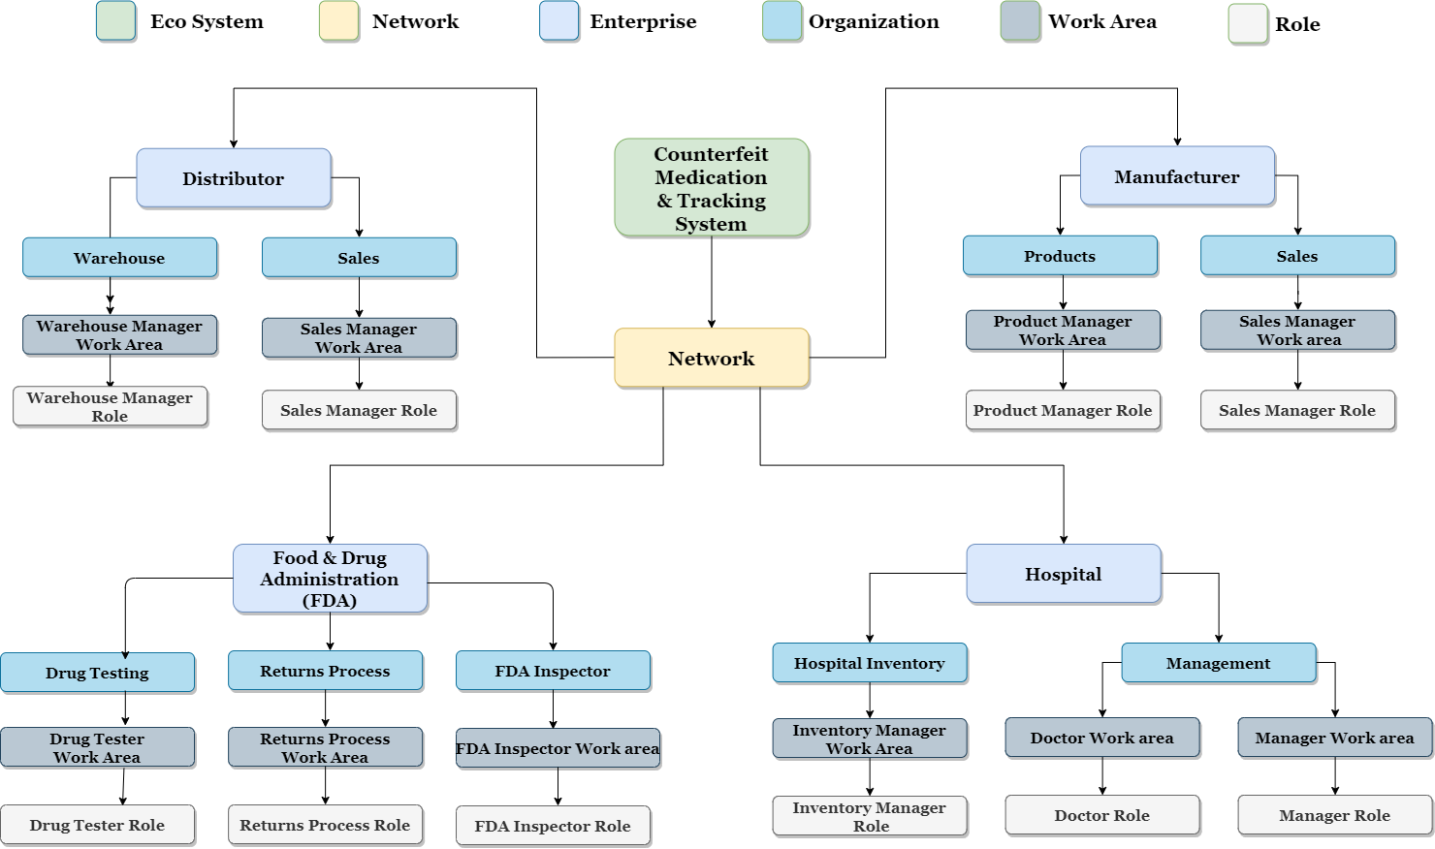
ECO SYSTEM ARCHITECTURE DIAGRAM

Slide 5
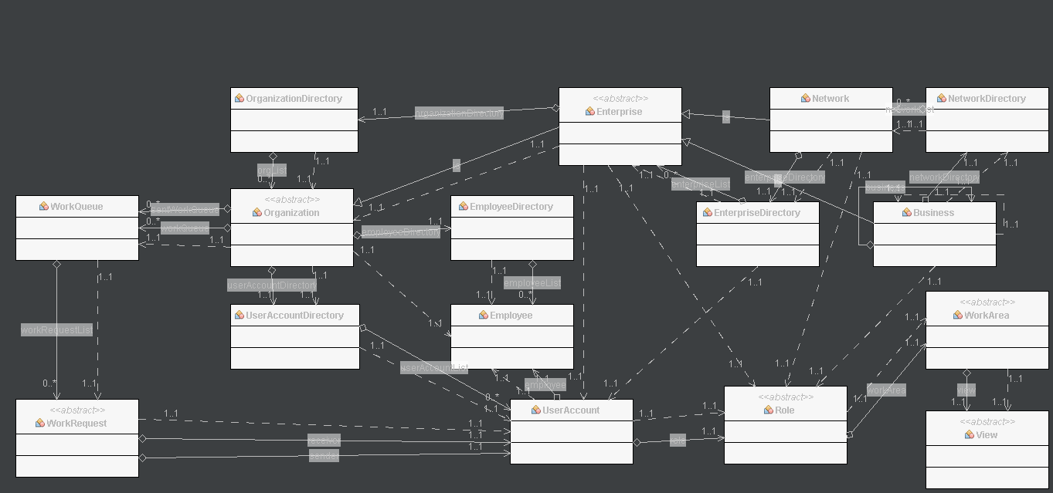
UML DIAGRAM

Slide 6
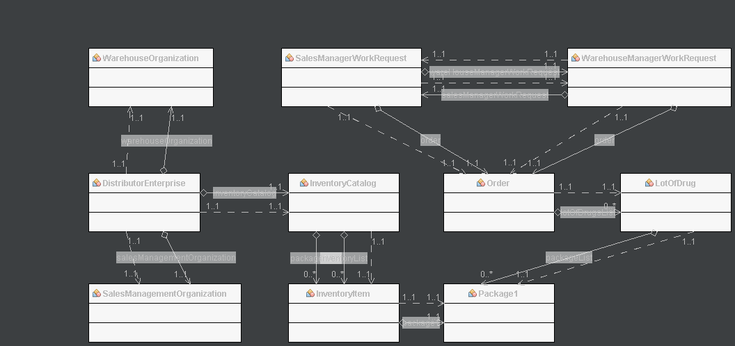
DISTRIBUTOR UML DIAGRAM

Slide 7
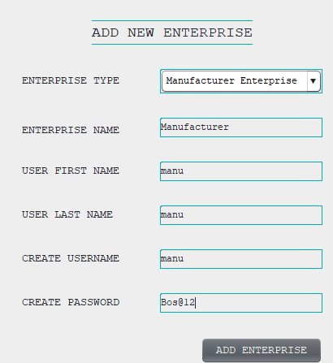
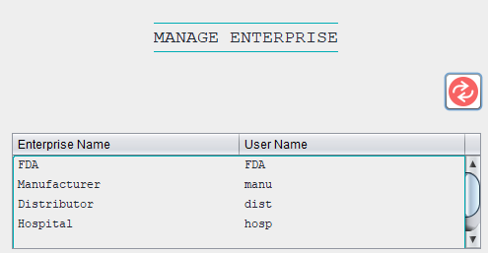
WORKFLOW PANELS: NETWORK ADMIN WORKFLOW
Network Admin adds new Enterprises
View of enterprise

Slide 8
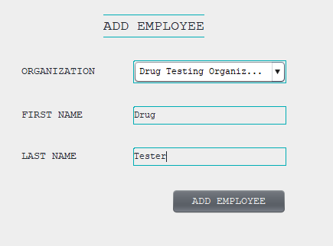
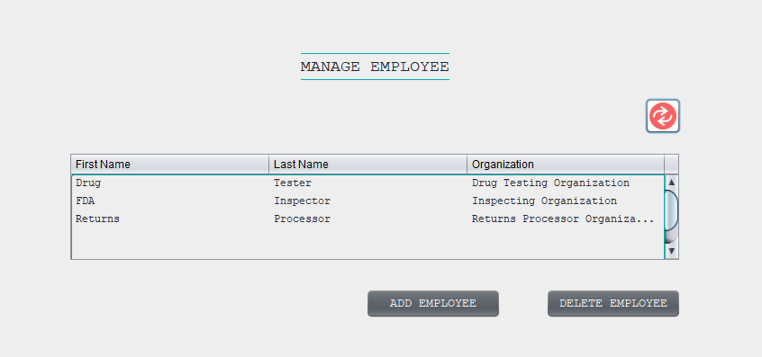
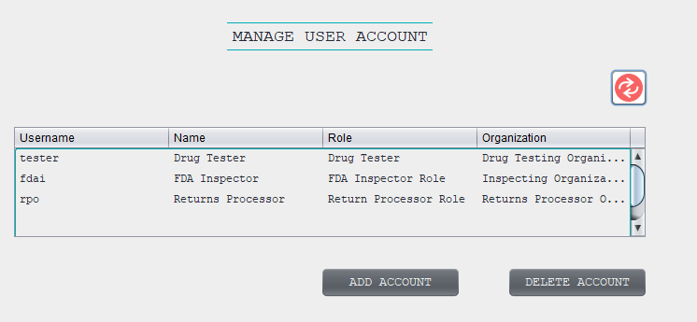
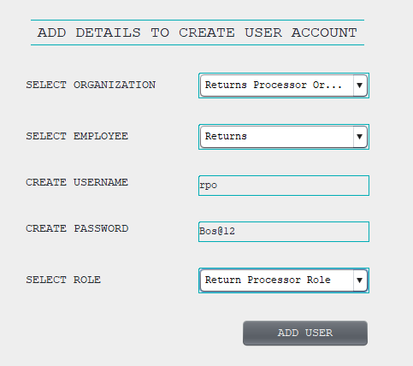
ENTERPRISE WORKFLOW
Enterprise admin manages employee and user account creation

Slide 9
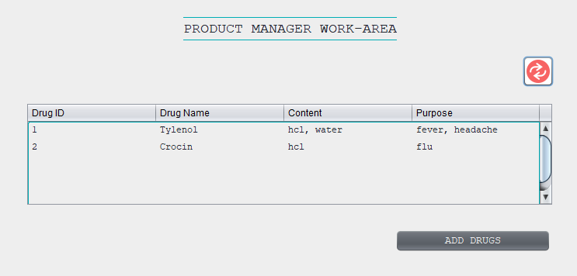
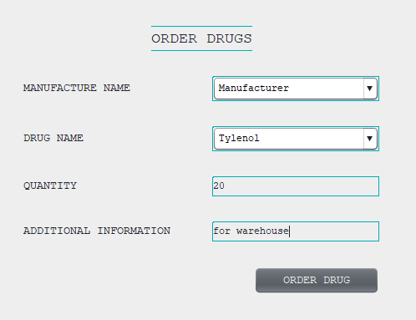
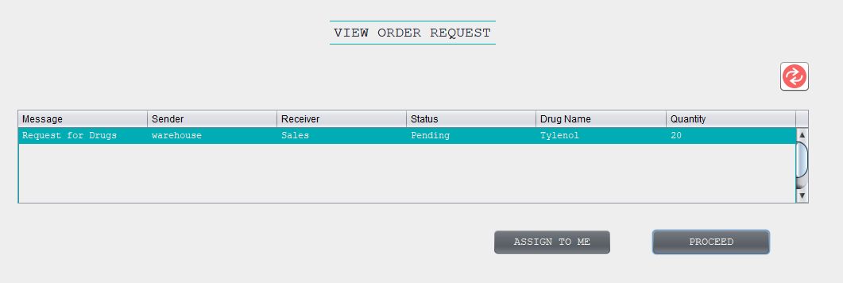
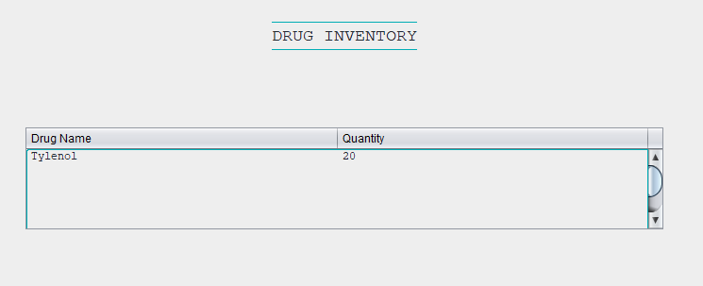
Manufacturer-Distributor Workflow
Distributor places an order based on drugs available in the catalog of manufacturer

Slide 10
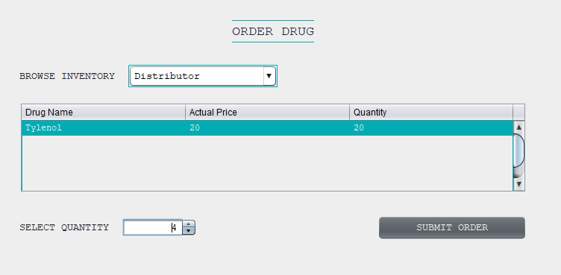
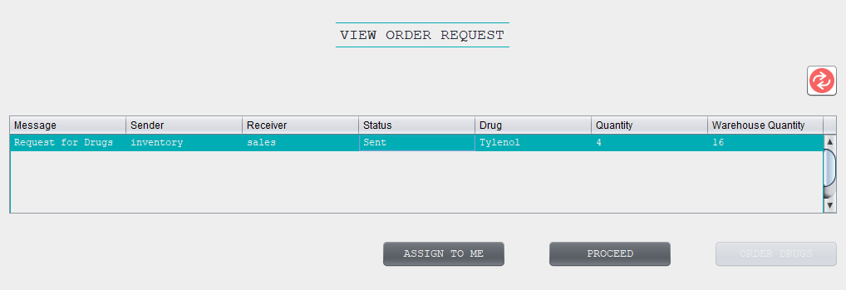
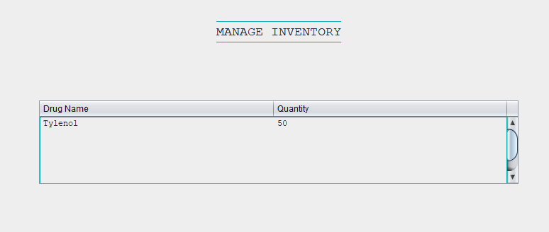
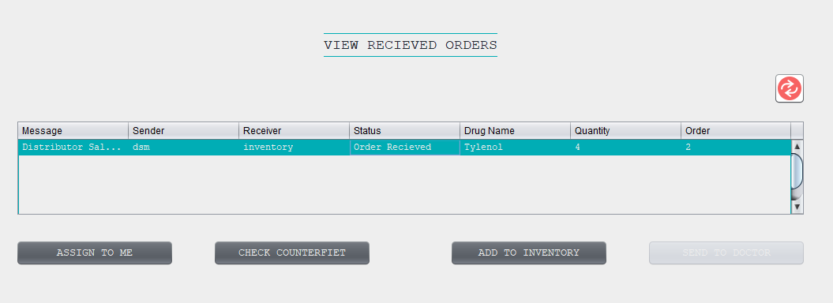
Hospital-Distributor Workflow
Hospital manager orders drugs for the inventory through distributor

Slide 11
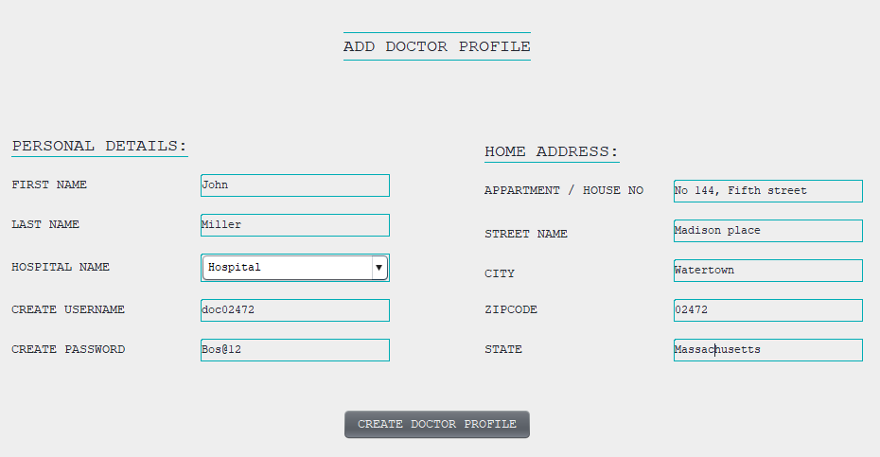
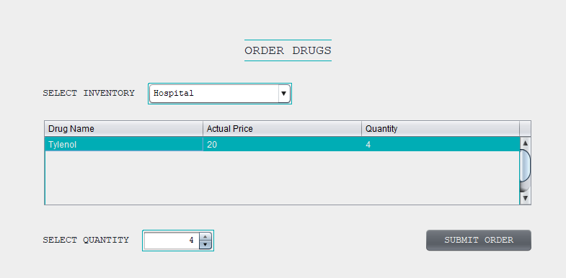
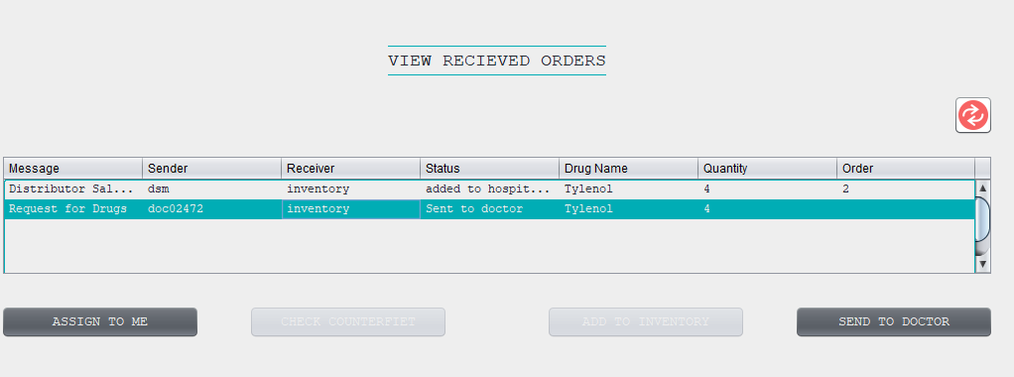
Doctor-Hospital Workflow
Hospital manager creates logins for the doctor and the doctor can place an order for drugs from the hospital inventory

Slide 12
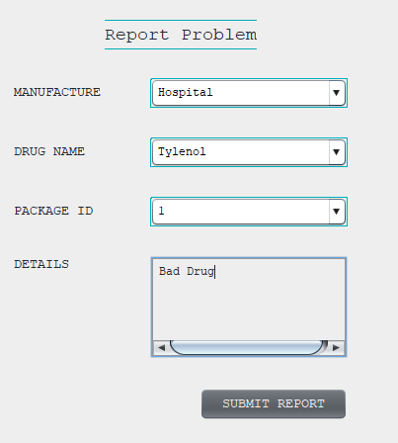
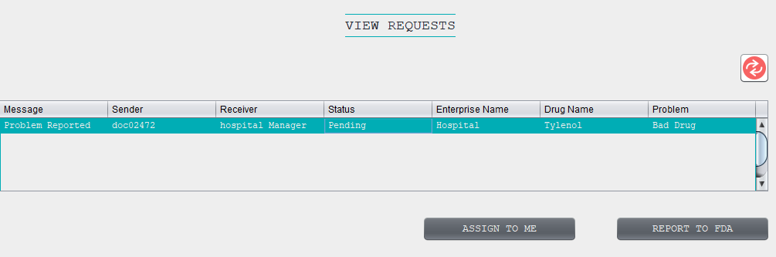
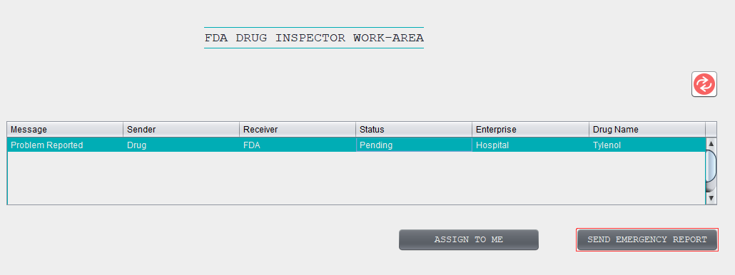
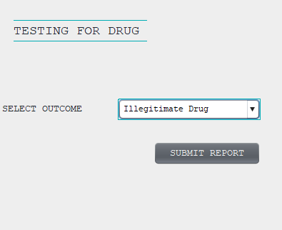
Illegitimate Report Workflow
Doctor files for a report in case he encounters an illegitimate drug

Slide 13
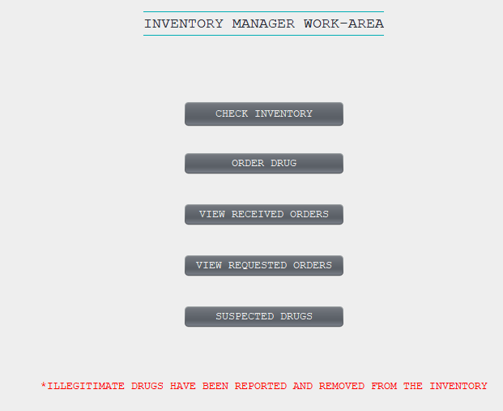
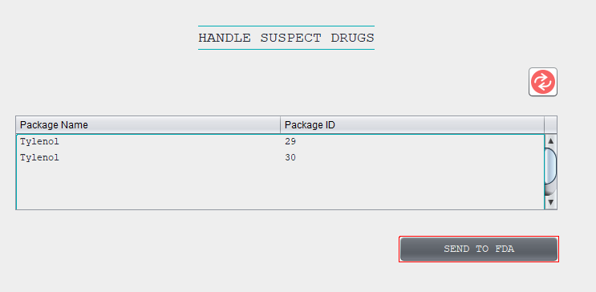
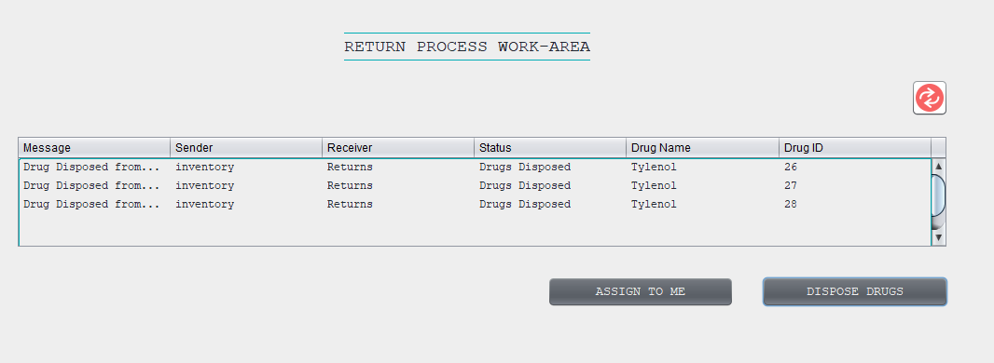
Drug Disposal Workflow
The illegitimate drugs are disposed by the returns processor from FDA

Slide 14
Roles
Network Admin:
Network admin can create Enterprise admin along with their user account.
Enterprise Admin:
Each Enterprise has Admin i.e. Manufacturer Admin, Distributor Admin etc.
They can create and delete user account

Slide 15
Enterprise Roles
Manufacturer:
Sales Manager - Receives requests for drugs from warehouse manager of Distributor
Product Manager - Adds drug to catalog
Distributor:
Sales Manager - Receives requests for drugs
Warehouse Manager - Requests for drugs, add to inventory

Slide 16
Enterprise Roles
Hospital:
Inventory Manager - Orders and adds drug to inventory
Hospital Manager - Adds Doctor profile, receives and reports illegitimate drug to FDA
Doctor - Orders drugs from inventory and reports illegitimate drug to FDA.
FDA:
Return Processor - Disposes reported illegitimate drugs
Drug Tester - Receives request from doctor, tests drug and send report to FDA
FDA Inspector - Receives test results and send notifications to related enterprises.

Slide 17
Thank you
Done by :
Srushti Dhamangaonkar
Naradwaj
Rahul Mahadev

